Slide 1

On Demand - HomeServices

Slide 2

ABC INSTITUTE OF TECHNOLOGY AND RESEARCH
Guided By: Presented By:
Prof. AAAAAA BBBBB
CCCCC

Slide 3

DEVELOPERS
BBBBB
CCCCC

Slide 4
ABSTRACT
This Online Home Services project deals with an online system designed for booking serviceman(electrician , carpenter , plumber , painter etc) as per the requirements of the customers at their convenience.
This software helps user to find serviceman profile and contact them or either click on book now button , after clicking on book now button , serviceperson will immediately contact to user.

Slide 5

ADMIN MODULES
Manage Servicemen's
Manage Users
Manage Bookings

Slide 6
SERVICEMEN MODULES
CREATE PROFILE
EDIT PROFILE
VIEW BOOKINGS

Slide 7
USER MODULES
SEARCH SERVICEMEN
VIEW SERVICEMEN PROFILE
BOOK SERVICEMEN

Slide 8
FRONTEND (LANGUAGE USED)
HTML(Hypertext Markup Language)
CSS(Cascading Style Sheet)
JAVASCRIPT
BOOTSTRAP(Framework of CSS and Javascript)

Slide 9

BACKEND
PYTHON DJANGO
SQLITE (DATABASE)

Slide 10
SOFTWARE USED
PYTHON INTERPRETER
PYCHARM IDE (INTEGRATED DEVELOPMENT ENVIRONMENT)
DJANGO FRAMEWORK
NOTEPAD++ OR ANY OTHER TEXT EDITOR
CHROME OR ANY OTHER BROWSER

Slide 11
USE CASE DIAGRAM
Use case diagram consists of use cases and actors and shows the interaction between them. The key points are:
The main purpose is to show the interaction between the use cases and the actor.
To represent the system requirement from user’s perspective.
The use cases are the functions that are to be performed in the module.
An actor could be the end-user of the system or an external system.

Slide 12
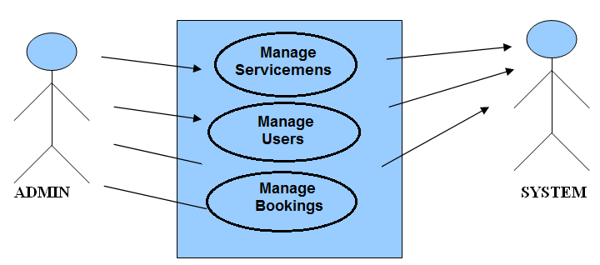
USE CASE - ADMIN

Slide 13
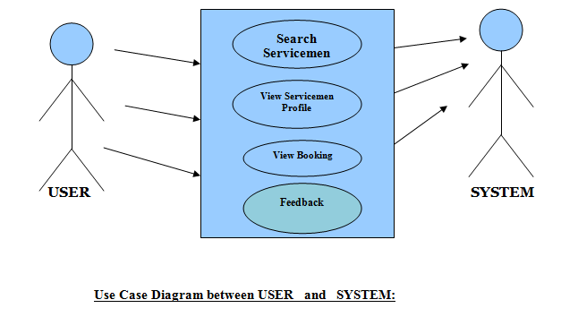
USE CASE - USER

Slide 14
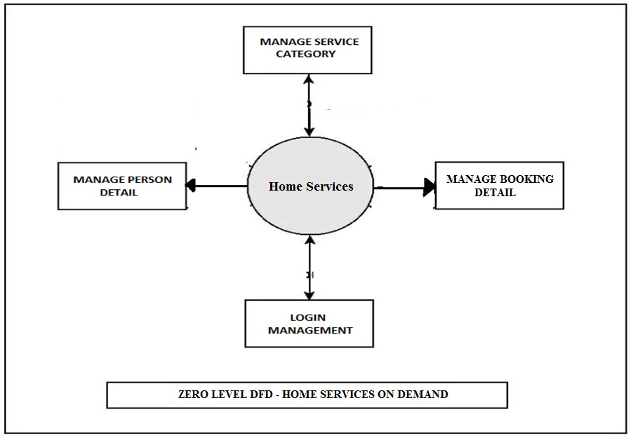
DFD(Data Flow Diagram)

Slide 15
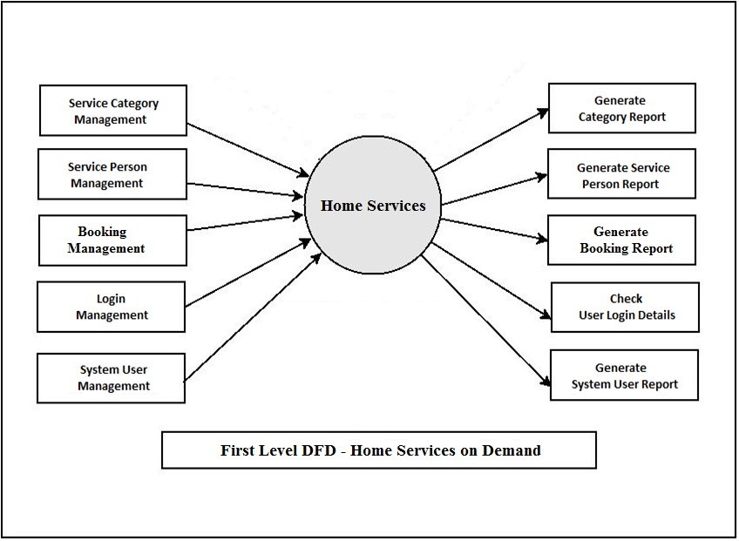
DFD(Data Flow Diagram)

Slide 16
ER DIAGRAM

Slide 17
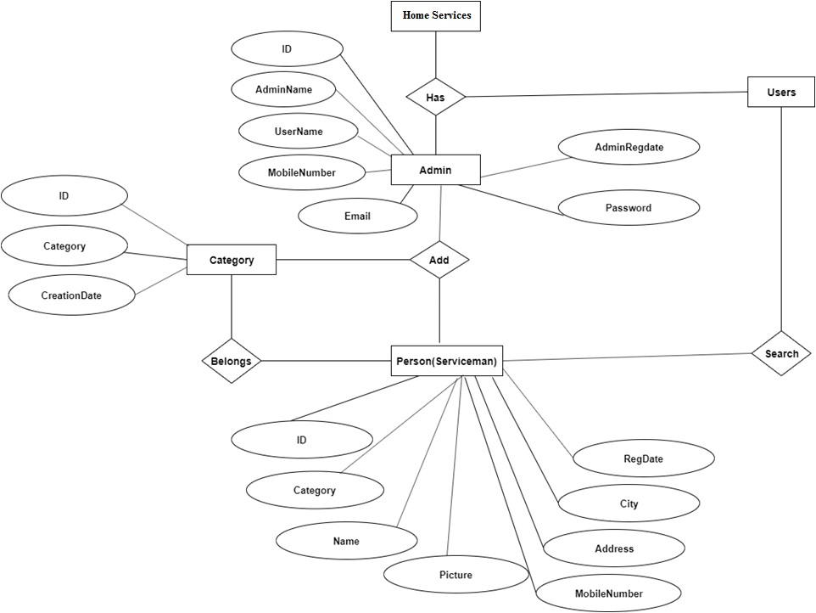

Slide 18
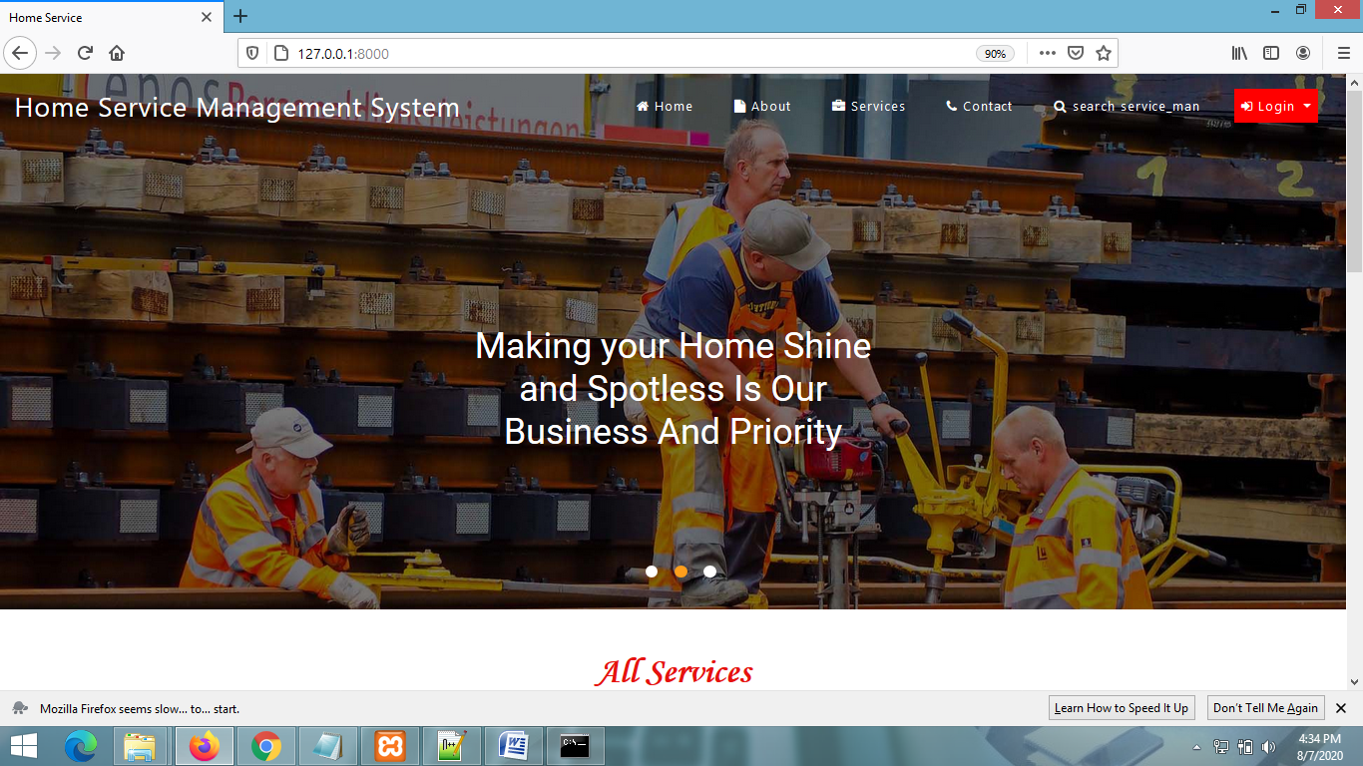
Home Page

Slide 19
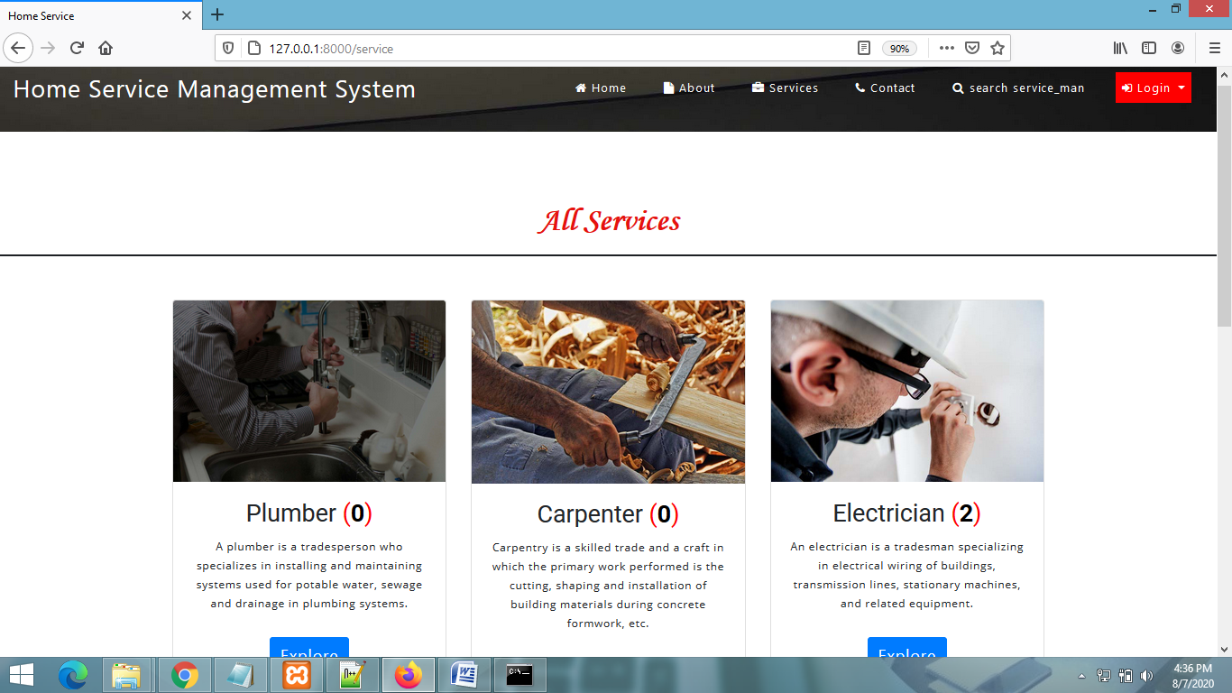
View All Services Page

Slide 20
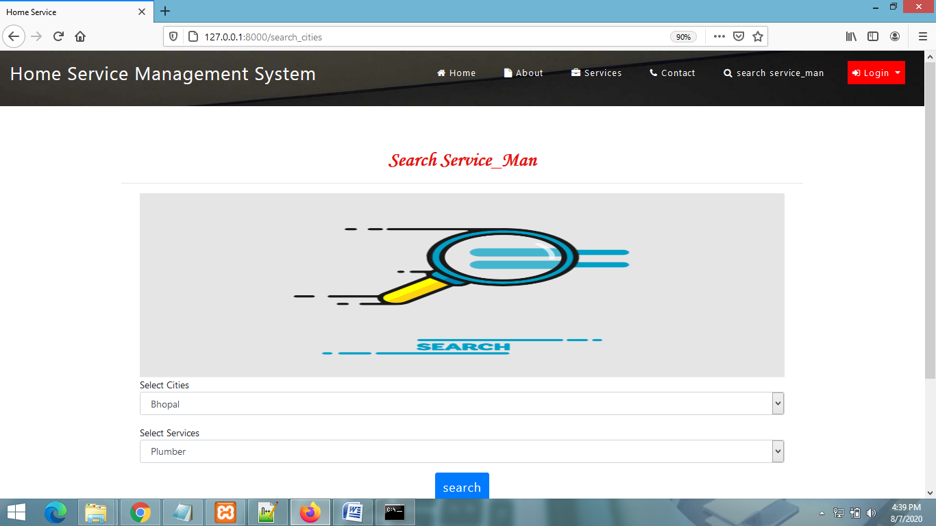
SEARCH SERVICEMEN PAGE

Slide 21
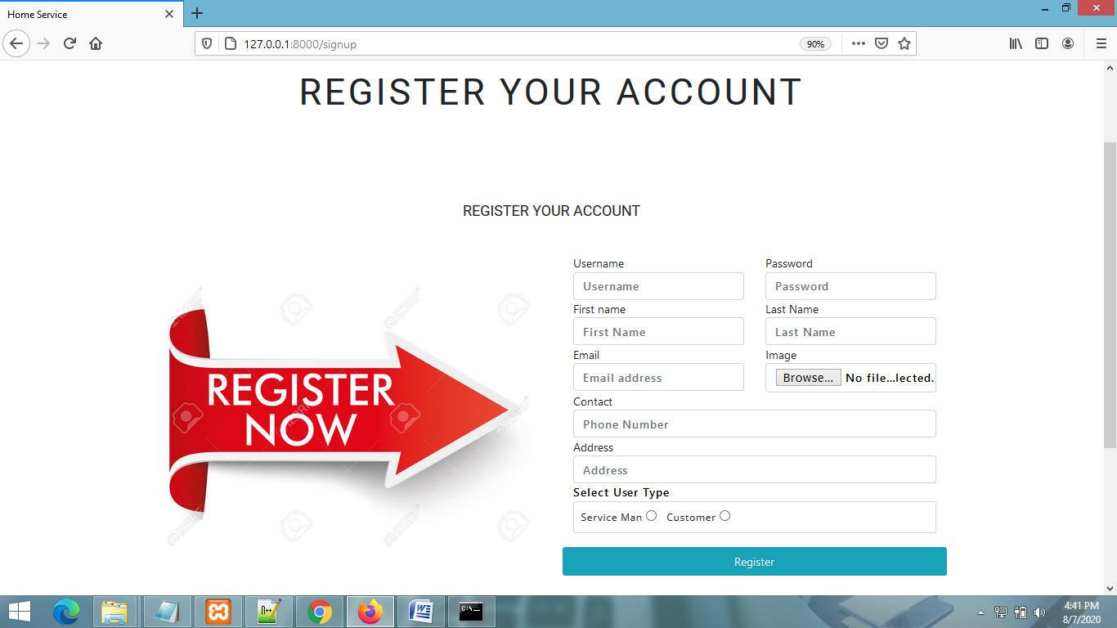
SIGNUP PAGE

Slide 22
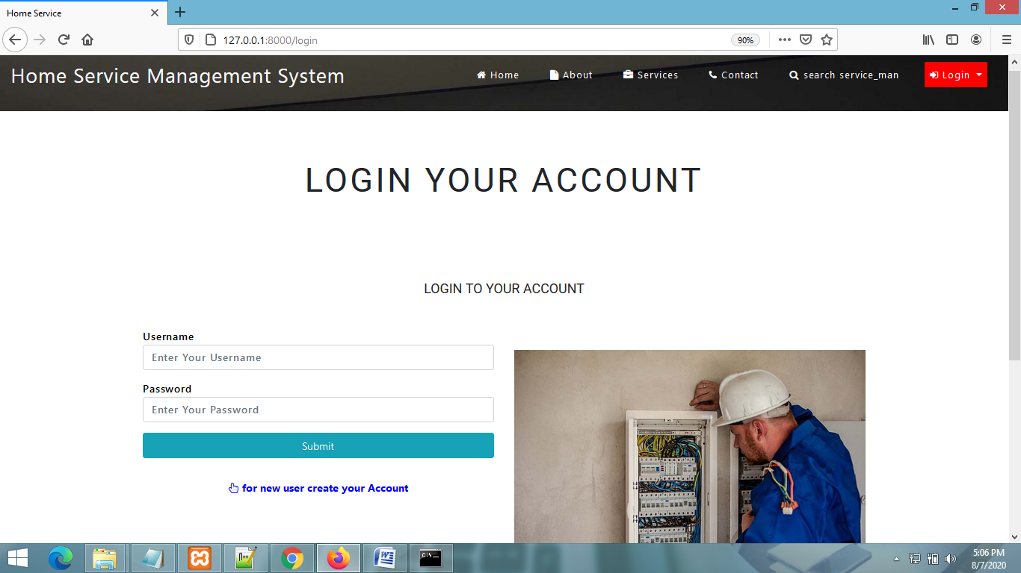
USER LOGIN PAGE

Slide 23
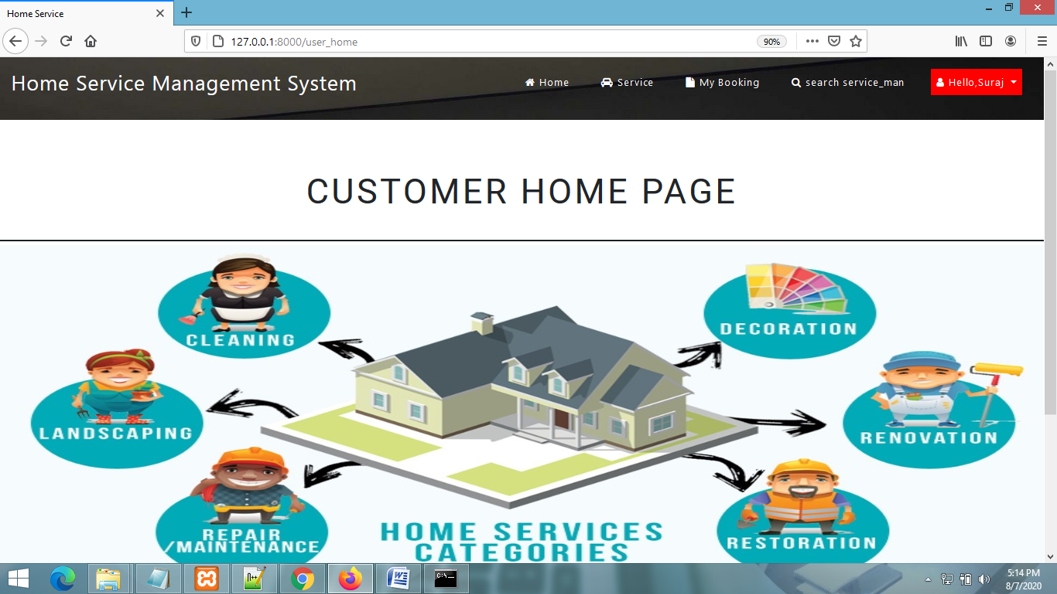
CUSTOMER HOME PAGE

Slide 24
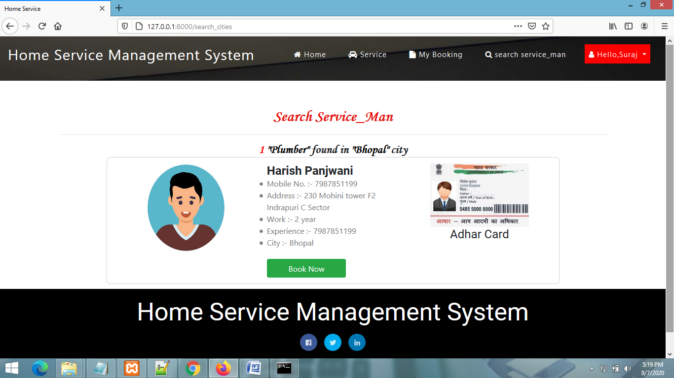
VIEW SERVICEMEN DETAIL

Slide 25
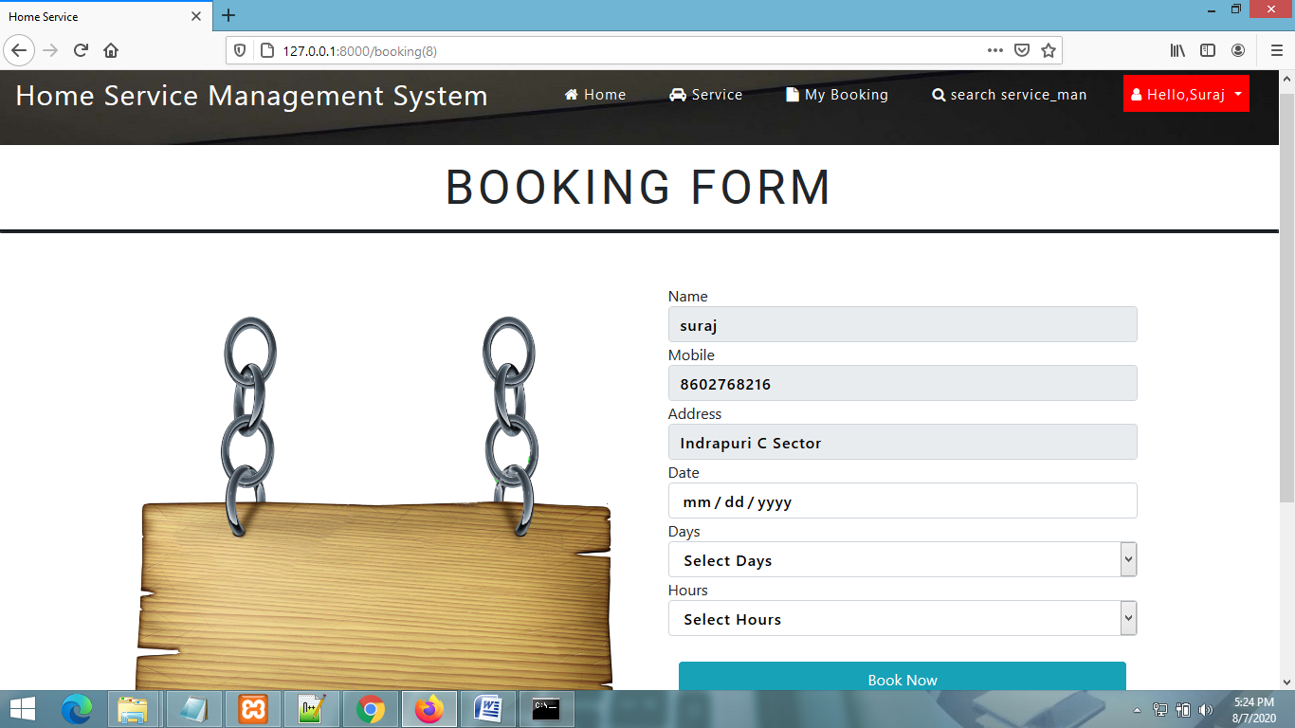
BOOKING PAGE

Slide 26
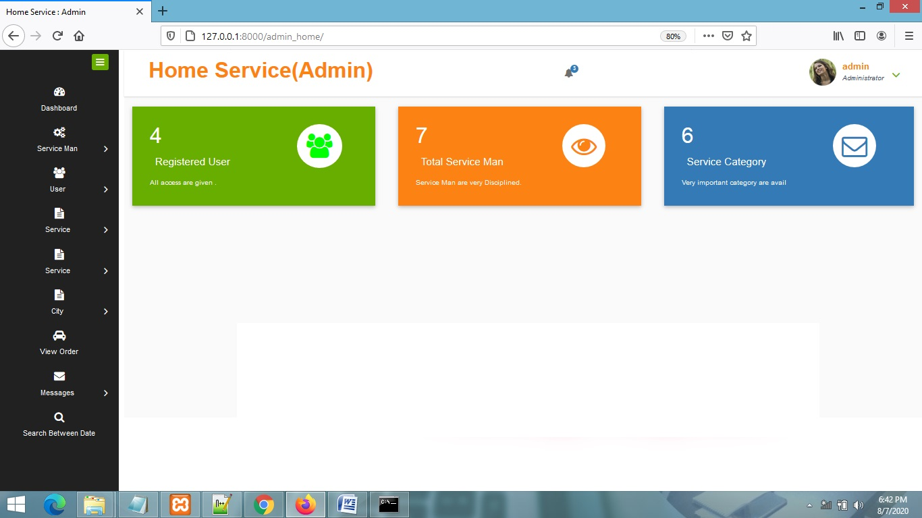
ADMIN HOME PAGE

Slide 27
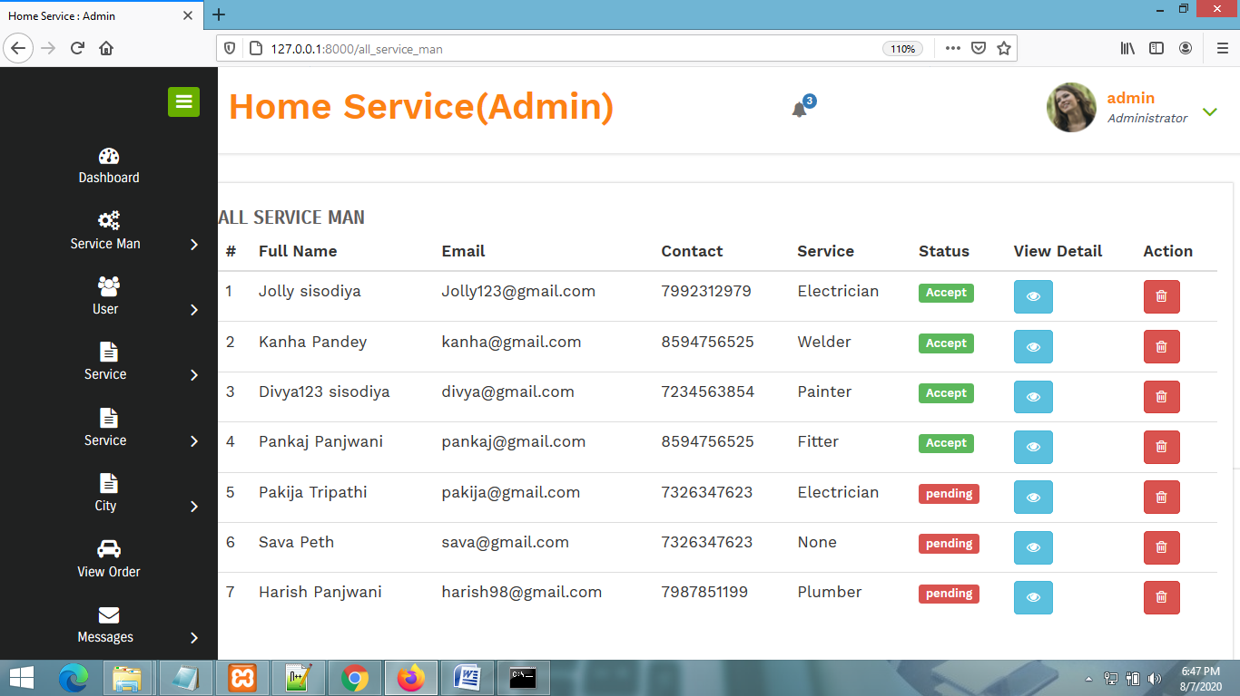
VIEW ALL SERVICEMEN PAGE

Slide 28
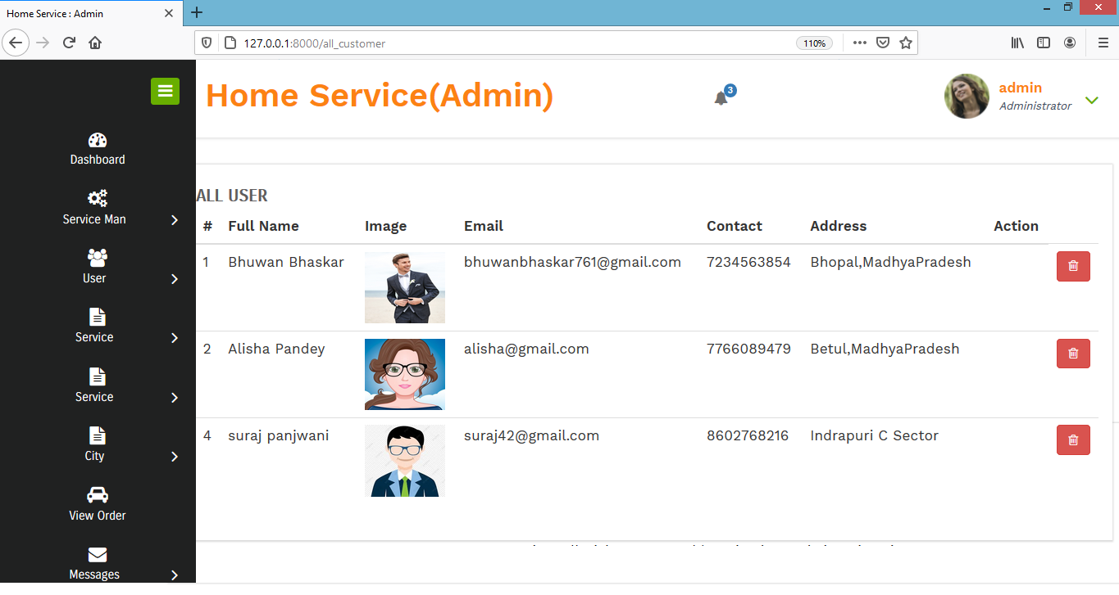
VIEW ALL USERS PAGE

Slide 29
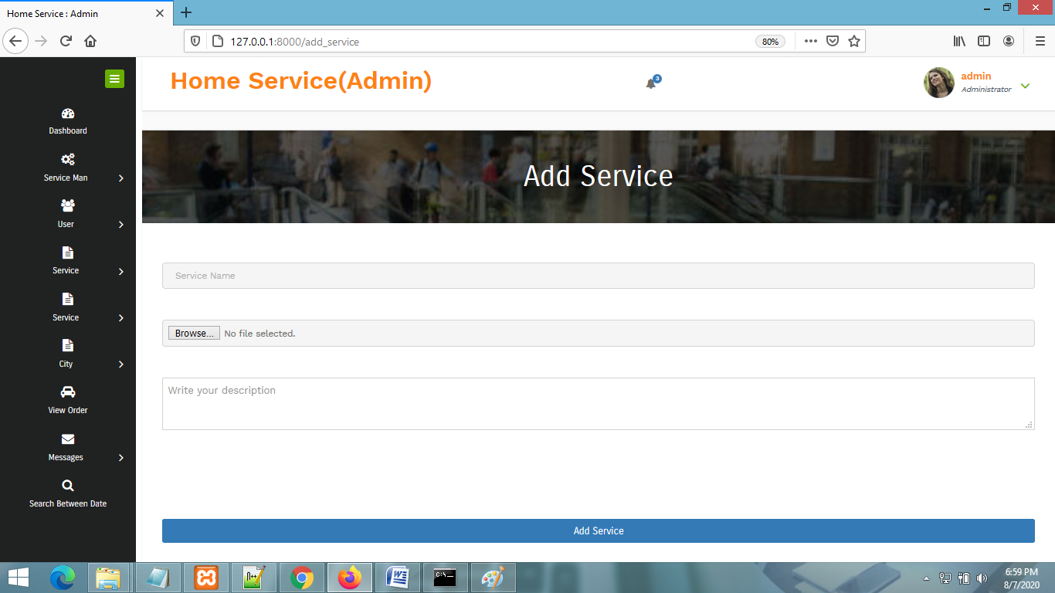
ADD SERVICE PAGE

Slide 30
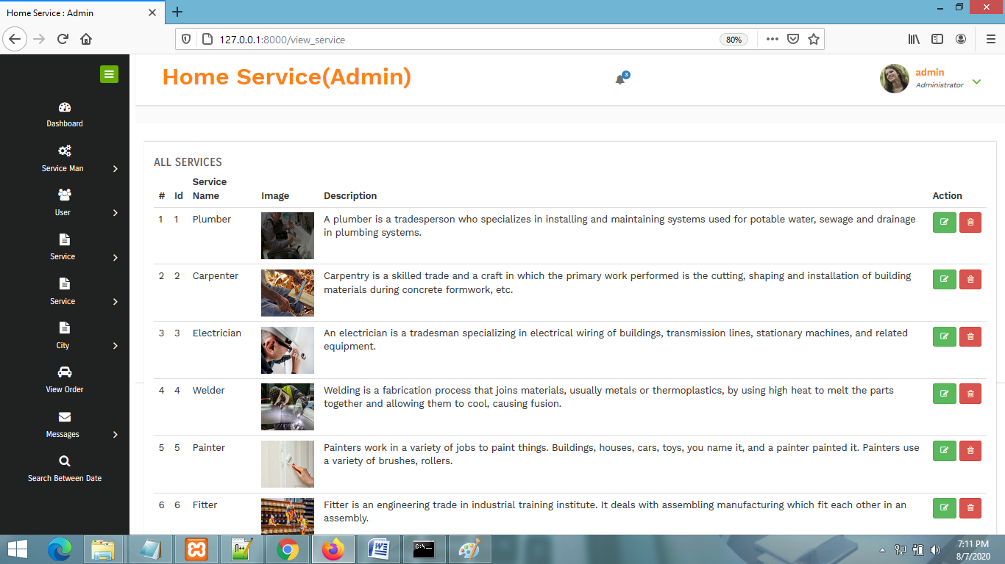
MANAGE SERVICES PAGE

Slide 31
CONCLUSION & FUTURE SCOPE
FUTURE SCOPE
This web application involves almost all the basic features of the online local services search engine management. The future implementation will be online help for the customers and chatting with website administrator.
CONCLUSION
The project entitled “Home services System” is developed using HTML,CSS and JS as front end and Python language and Sqlite database in back end to computerize the process of online serviceman booking. This project covers only the basic features required.

Slide 32
BIBLIOGRAPHY
FOR PYTHON INSTALLATION
https://www.python.org
FOR HTML , CSS ANF PYTHON BASICS
www.w3schools.com
www.javatpoint.com
https://www.geeksforgeeks.org/python-django/
REFERENCE BOOKS
Two scoops of Django for 1.11 by Daniel Greenfeld’s and Audrey Greenfield
Lightweight Django by Elman and Mark Lavin

Slide 33
THANKYOU

